Slide 1


Building a Flutter App with Firebase Authentication
A Hands-On Guide to Your Assignment

Slide 2

The Big Picture: Why Authentication Matters
Think about your most-used apps: Gmail, Amazon, Facebook. They all start with a sign-in screen. User authentication is the gateway to personalized experiences and secure data.
Your Assignment Goal
Your mission is to build a Flutter application that integrates with Firebase Authentication. This will allow users to register for an account and sign in using an email and password, giving you fundamental, real-world skills in mobile development.

Slide 3
The Assignment Breakdown: What Needs to Be Done?
Let's break down the core objectives of the assignment. You're building a full authentication flow from the ground up.
1. Set Up Firebase
2. Build the User Interface
3. Implement the Logic
You'll configure a Firebase project to act as the secure backend for your application, where user credentials will be stored.
You will be responsible for creating the UI components: a registration screen, a sign-in screen, and a new profile screen.
This is the key part: writing the code that connects your Flutter UI to Firebase for creating accounts and verifying credentials.

Slide 4
Your Two Key Enhancements
The provided code gives you a starting point. Your main task is to build upon it by adding these two crucial features.
A New Profile Screen
A Functional Logout Button
Create a new screen that appears after a successful login.
Implement the logic for the sign-out functionality.
Display the currently logged-in user's email.
Ensure that tapping 'Logout' signs the user out of Firebase.
This screen will confirm that the authentication flow is working.
Redirect the user back to the login screen after a successful logout.

Slide 5
Your Step-by-Step Game Plan
Follow this plan in order to stay organized and ensure you complete all requirements.

Slide 6
Step 1: Firebase Project Setup
Reuse a Firebase project you've previously created if possible. Otherwise, create a new one.
Navigate to the 'Authentication' section in the Firebase console.
Click on the 'Sign-in method' tab.
Enable the 'Email/Password' provider. This is a critical, non-negotiable step!

Slide 7
Step 2: Flutter Project & Dependencies
Create a new Flutter project or use the one provided.
Add the two crucial Firebase dependencies to your `pubspec.yaml` by running these commands:
`flutter pub add firebase_core`
`flutter pub add firebase_auth`
Ensure your project is connected to Firebase via the `firebase_options.dart` file (generated using the FlutterFire CLI).

Slide 8
Step 3: Understand the Provided Code
The starter code already does the heavy lifting. Take five minutes to review it.
**`MyHomePage`**: Currently shows both registration and sign-in forms simultaneously.
**`RegisterEmailSection`**: Contains the form and logic for user registration using `createUserWithEmailAndPassword`.
**`EmailPasswordForm`**: Contains the form and logic for user sign-in using `signInWithEmailAndPassword`.
**`_signOut` Method**: A basic sign-out function is already present in the AppBar.

Slide 9
Step 4: Build the Profile Screen (Task 1)
This is your first major coding task: creating a new widget to display after login.
Create a new `StatefulWidget` for your `ProfileScreen`.
Fetch the current user's data with `FirebaseAuth.instance.currentUser`.
Display the user's email in a `Text` widget: `currentUser?.email`.
**Bonus**: Add a button to change the password. You'll need a simple form and the `currentUser?.updatePassword(newPassword)` method.

Slide 10
Step 5: Implement Navigation & Logout (Task 2)
Connect your screens together to create a seamless user flow.
**Login Navigation**: In the `_signInWithEmailAndPassword` method, after a successful login, use `Navigator` to push the new `ProfileScreen` onto the stack.
**Logout Navigation**: In the `_signOut` method, after calling the sign-out function, navigate the user back to the login screen.
**Pro-Tip**: Use `Navigator.pushAndRemoveUntil` on logout to clear the navigation history, preventing the user from pressing 'back' to get into the profile screen.

Slide 11
Step 6: Testing & Submission
The final and most important step is to verify your work and submit it correctly.
Test Thoroughly
Build the APK
Provide GitHub Link
Register a new user. Log out. Log back in. Change the password. Log out and in again. Ensure every part of the flow works.
You must build and submit an Android APK file. This is a mandatory part of the submission.
Your submission must also include a link to your public GitHub repository containing the complete source code.

Slide 12
Pro-Tips for Success
Validate Inputs
Handle Errors
Manage State
Go beyond empty-field checks. Add validation for email format (contains '@') and password length (at least 6 characters for Firebase).
Improve the `try-catch` blocks. Catch specific Firebase exceptions like 'email-already-in-use' or 'wrong-password' to show user-friendly messages.
After any authentication state change (login or logout), remember to call `setState` to trigger a UI rebuild and show the correct screen.

Slide 13
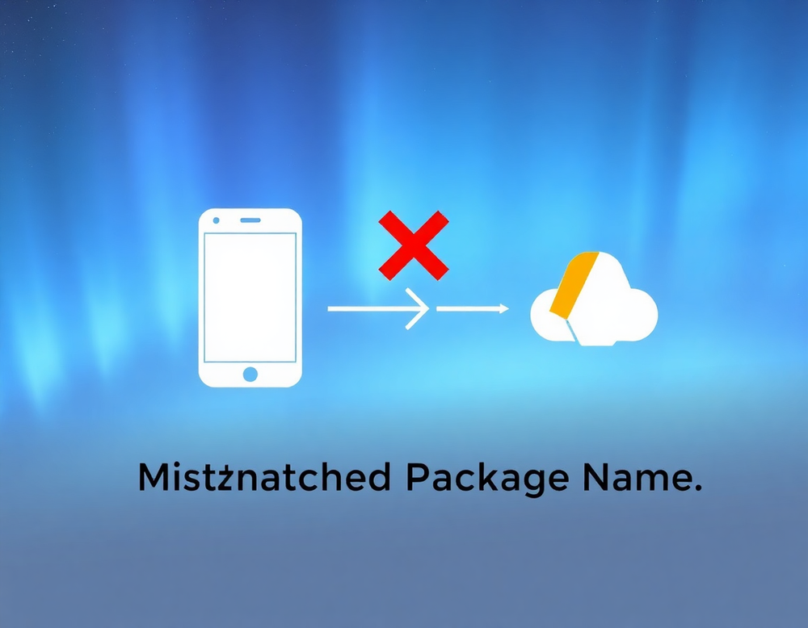
Common Pitfall: Firebase Configuration
The single most common issue is an incorrect Firebase setup. A small typo can prevent your app from ever connecting to the backend.
What to Double-Check
Open `android/app/build.gradle`.
Find the `applicationId`.
Ensure this ID **exactly** matches the Android package name you registered in your Firebase project settings. No typos!

Slide 14

Conclusion: You've Got This!
You now have the complete roadmap and all the tools you need. This assignment is a fantastic opportunity to build a core feature you will use in countless future applications.
Good luck, and happy coding!

